Slide 1
Lean Supply Chain Management
MBAD 6208 | Fall 2018| Group 6: Joshua rodgers, José Corona, Akshata Kanumuri

Slide 2
Agenda
What is Lean Thinking?
Relevance to Supply Chain Management (SCM)
Typical Wastes to Look for
General Actions for Supply Chain Managers
Expected Payoffs of a Lean Supply Chain
Examples of Lean in Use
Conclusion/ Q&A
References

Slide 3
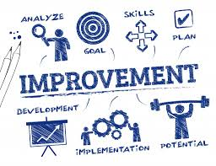
What is Lean Thinking?
Business Philosophy not a Program or Initiative
Maximize Customer Value with Available Resources
Improve Efficiencies
Improve Quality Product or service
Eliminate Defects
Six Sigma Service Level
At most 3.4 defects per million opportunities
Not enough to be 99% or even 99.9% correct
Process accuracy of 99.99966%
Meet Customer Expectations
Understand Expectations
Remove over and under-processing
Reduce Waste
Anything that Costs time or money, but doesn’t create value from the customer’s perspective

Slide 4
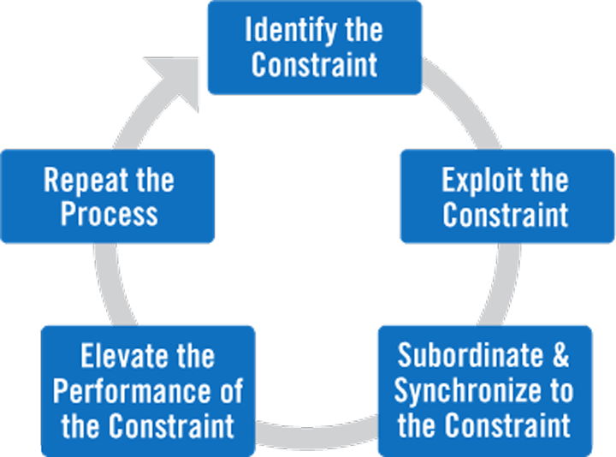
What is Lean Thinking? (Continued)
Theory of Constraints
Focused on System Improvement
System- A series of interdependent processes
Throughput based over cost based
Little’s Law => WIP = Throughput * Lead Time
The Process that slows the speed of product through the system is the constraint

Slide 5
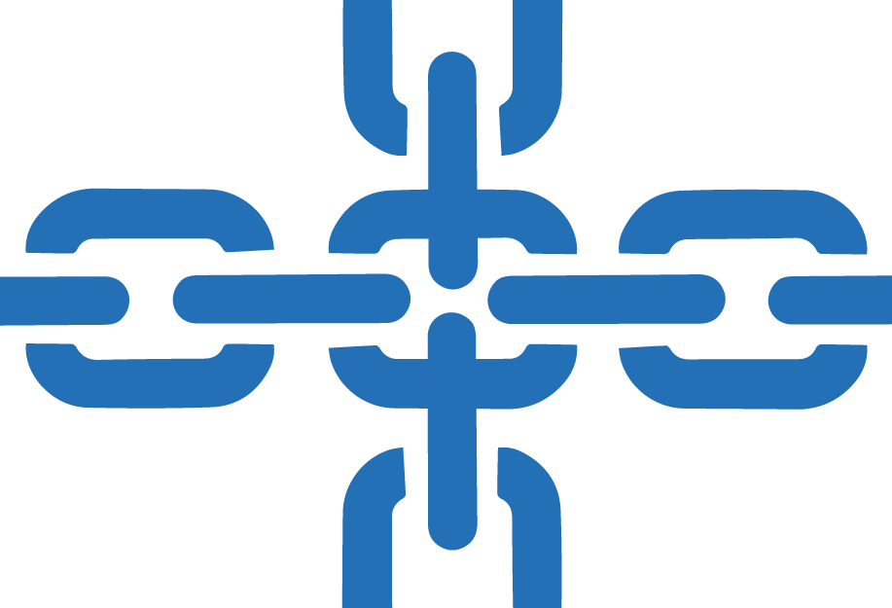
Relevance to Supply Chain Management
“The Performance of the entire chain is limited by the strength of the weakest link”
Supply Chains are Systems of processes
Every Process can be continually improved
Dr. M. Srinivasan (University of Texas- Knoxville) wrote 14 principles for a Lean Supply Chain
Principle 1: “Improvements in Subsystem Performance must be Gauged only through their impact on the whole system”.
Optimize Supply Chain, not Individual enterprise
Improved Supply Chains provide competitive advantages

Slide 6
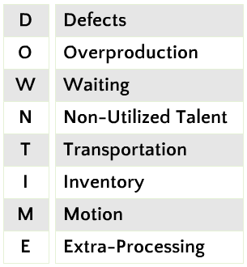
Typical Wastes to look for
Defects – Products or services that are out of specification that require resources to correct.
Overproduction – Producing too much of a product before it is ready to be sold.
Waiting – Waiting for the previous step in the process to complete.
Non-Utilized Talent – Employees that are not effectively engaged in the process. (Underutilized)
Transportation – Transporting items or information that is not required to perform the process from one location to another.
Inventory – Inventory or information that is sitting idle (not being processed).
Motion – People, information or equipment making unnecessary motion due to workspace layout, ergonomic issues or searching for misplaced items.
Extra Processing – Performing any activity that is not necessary to produce a functioning product or service.

Slide 7
General Actions for Supply Chain Managers
Eliminate All Waste in the Supply Chain So That Only Value Remains: Creating a smooth flow of products downstream in a lean supply chain requires all departments and functions in the organization to work in collaboration. Thus eliminating the above described wastes
Consider Advancements in Technology To Improve The Supply Chain: Technologies like Omni-channel fulfillment, RFID, Customer Order Management, Customer Relationship Management (CRM)/Cloud Solutions, GPS for tracking freight ,etc.
Make Customer Usage Visible To All Members of The Supply Chain: Flow in the lean supply chain begins with customer usage. Visibility to customer usage for all supply chain partners is critical. This sets the supply chain pace.
Reduce Lead Time: Reducing inbound and outbound transportation logistics gets us closer to customer demand which results in reduced reliance on forecasting, increased flexibility, and reduced waste of "overproduction”.
Create a Level Flow/Level Load: Leveling the flow of material and information results in a lean supply chain with much less waste at all critical points in the system.

Slide 8
General Actions for Supply Chain Managers
Use Pull Systems: Pull systems reduce wasteful complexity in planning and overproduction. Components are replaced when they have been consumed. Make enough to meet customer demand.
Increase Velocity, Throughput and Reduce Variation: Fulfilling customer demand through delivery of smaller shipments, more frequently increases velocity and throughput to the customers. This, in turn, helps to reduce inventories and lead times and allows us to more easily adjust delivery to meet actual customer need consumption.
Collaborate and Use Process Discipline: When all members of the lean supply chain can see if they are operating in concert with customer need consumption, they can more easily collaborate to identify problems, determine root causes, and develop appropriate solutions to solve any root cause problems.
Focus on Total Cost of Fulfillment: Make decisions that will meet customer expectations at the lowest possible total cost, no matter where they occur along the supply chain. This means eliminating decisions that benefit only one part of the stream at the expense of others.

Slide 9
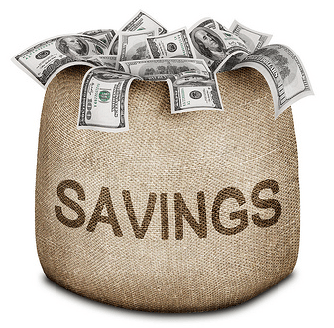
Expected Payoffs of Making the Supply Chain Lean
Lead Time (Cycle Time) reduction
Increase in Productivity
Reduction in Work-In-Process Inventory
Quality improvement
Reduction in space utilization
Increased customer fill rate and customer satisfaction
Supply chain visibility and increased performance measurement
Risk Management

Slide 10
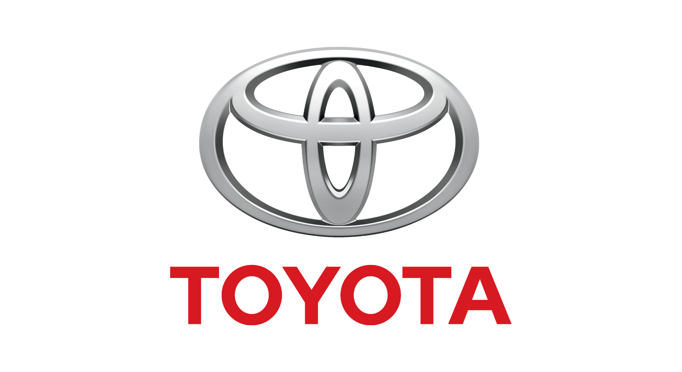
Examples of LEAN in use: Automotive
Top 3 automaker in the U.S. with $264.68 billion in revenue (10.4 million vehicles) as of March 2018
Founder of the “lean principle” with a focus on “just in time” delivery to achieve higher quality products with fewer defects, reduced handling and storage costs
To achieve this Toyota has developed a close relationships with suppliers
From vertical to horizontal flow of information through supply chain
In-house and out-house departments that collaborate with its suppliers to improve production processes
Cross-functional teams with suppliers that run the drawings and production process to improve quality and shorten lead times
Main focus is the Toyota New Global Architecture (TNGA) to improve production process
Uses smart sharing and total optimization collaboration with its suppliers
Has improved quality and product performance thus providing better lead times

Slide 11

Examples of LEAN in use: Retail
More than 700 factories located in 42 countries
Has been applying lean supply chain managements in order to reduce its lead times by 83.3%
From 60 days to 10 days
By redesigning logistics network, nearshoring more facilities, improving contract manufactures relationships, and investing in automation
Consumer demand business model to deliver what consumers want, when they want it and where they want it
Relying on new manufacturing methods and automation
Opened up Advanced Product Creation Center
Has found how to produce footwear uppers with 30% fewer steps and up to 50% less labor
By 2023, Nike plans to produce tens of millions of pairs nearshore with 25% of them delivered on a short lead time responsive model

Slide 12

Conclusion/ Q&A

Slide 13
References
https://www.processexcellencenetwork.com/business-transformation/articles/the-8-deadly-lean-wastes-downtime
https://www.ukessays.com/essays/business/principles-benefits-limitations-of-lean-supply-chain-business-essay.php
https://www.thebalancesmb.com/lean-supply-chain-management-2221274
https://goleansixsigma.com/8-wastes/
https://www.supplychaindive.com/news/nike-lead-times-innovation-automation-consumer/508606/
https://corporatenews.pressroom.toyota.com/releases/tmc+announces+financial+results+for+fiscal+year+ended+march+31+2018.htm
https://cerasis.com/2015/05/06/lean-supply-chain/
https://www.leanproduction.com/theory-of-constraints.html
https://www.lean.org/WhatsLean/
https://www.lean.org/Search/Documents/242.pdf

